Slide 1
Basic Class, Arithmetic Operation, Logic and Relational Operation Session 2
Course : COMP 6175
Object Oriented Programming
Effective Period : October 2018

Slide 2
Outline
Wrapper Class Introduction
Wrap Class Method
Data type in Wrapper Class
Wrap Class Method
String and String Method
Math Method and Math Method
Arithmetic Expressions
Increment / decrement Operator
Relational / Comparison Operation and Operator
Boolean / Logic Operation and Operator
Truth Table
Exception Handling

Slide 3
Introduction to Wrapper Class
All primitive data types are wrapped into a class in Java and is fixed.
Contains in java.lang package
Used to symbolize the primitive data types in an object if necessary.
Is the final class and interface.

Slide 4
Data Type to be Wrapped
There are 8 primitive data type to be wrapped as Class in Java
Primitive type | Wrapper class | Constructor Arguments
byte | Byte | byte or String
short | Short | short or String
int | Integer | int or String
long | Long | long or String
float | Float | float, double or String
double | Double | double or String
char | Character | char
boolean | Boolean | boolean or String
Instance of the
class Number

Slide 5
Wrapper Class Method
All numeric class which is derived from abstract class Numeric have method doubleValue(), floatValue(), intValue(), longValue(), shortValue() and byteValue(), which will return the value in accordance with its data type.
Every Wrapped class will override toString and equals functions which has been define by class Object.
Some numerical and character classes implement the interface Comparable, compareTo function implemented in its class.

Slide 6
Wrapper Class Constants
Each numeric class has constants :
MAX_VALUE
MIN_VALUE
MAX_VALUE : maximum value according to its data type
MIN_VALUE : minimum value
For byte, short, int and long.
For float and double showing positive values.
Max integer value = 2.147.483.647
Min float value = (1.4E-45)
Max double floating point value = (1.79769313486231570e+308d)

Slide 7
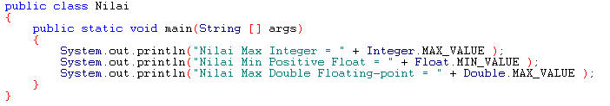
Wrapper Class Constants ( Cont’d.. )
Example of use :
Output :

Slide 8


Conversion Function
When initialize a value in the form of a string, we can use the static function valueOf or directly using constructor.
using valueOf using Constructor
When parsing a value in form of a string, we can use parseInt, parseDouble, parseFloat, parseLong, parseShort, parseByte function which according to its data type.

Slide 9
String
A collection of some characters into an array (Array of Character)
Declaration :
String msg = new String(“Welcome to Java”);
Atau
String msg = “Welcome to Java”;
Also could be create from a collection of characters :
char[] charArray = {‘G’,’o’,’o’,’d’,’ ‘,’D’,’a’,’y’};
String msg = new String(charArray);
String Literal Object

Slide 10
String (Cont’d…)
Comparing String
Using operator ==
if(word1 == word2) System.out.print(“word 1 and 2 same object”);
Using equals method
if(word1.equals(word2)) System.out.print(“word 1 and 2 same contains”);
Using compareTo method
word1.compareTo(word2)
Will return 0 (zero) if word1 equals to word2. If not 0, than word1 is not the same form with word2

Slide 11
String Method
Functions of String Class:
length()
To find out how the length of the string
Example : msg.length();
charAt(index)
To restore the specific character designated by the index
Example : String msg =“Welcome”;
msg.charAt(0) ← then the result : W
concat()
To combine strings
Example: String word3 = word1.concat(word2);
but we used to use String word3 = word1 + word2;
substring(start,finish)
To take a few characters from a string of the index.
Example : String msg = “Welcome to Java”
msg.substring(0,6); ← then the result : Welcome
toLowerCase()
To convert all letters to lowercase
Example : “Welcome”.toLowerCase(); ← then the result : welcome

Slide 12
String Method ( Cont’d… )
toUpperCase()
To convert all letters to uppercase
Example: “Welcome”.toUpperCase(); ← then the result WELCOME
trim()
To eliminate the blank character in string
Example: “ W el com e “.trim(); ← then the result Welcome
replace(character1, character2)
To overwrite all the first character in the string with the second character
Example : “Welcome”.replace(‘e’,’o’); ← then the result Wolcomo
replaceFirst(character1, character2)
To override the first character only of a string with second characters
Example: “Welcome”.replaceFirst(‘e’,’o’); ← then the result Wolcome
split(format,limit)
To divide into multiple strings in a string with a particular format.
Example: String [] a = “Welcome#to#Java”.split(“#”,0);

Slide 13
Common used String Methods
Methods | Description
length() | Returns the length of this string.
charAt(index) | Returns the char value at the specified index.
concat() | Concatenates the specified string to the end of this string.
substring(start,finish) | Returns a new string that is a substring of this string.
toLowerCase() | Converts all of the characters in this String to lower case using the rules of the default locale.
toUpperCase() | Converts all of the characters in this String to upper case using the rules of the default locale.
trim() | Returns a copy of the string, with leading and trailing whitespace omitted.
replace(char oldChar, char newChar) | Returns a new string resulting from replacing all occurrences of oldChar in this string with newChar.
replaceFirst(String regex, String replacement) | Replaces the first substring of this string that matches the given regular expression with the given replacement.
split(String regex, int limit) | Splits this string around matches of the given regular expression.

Slide 14
Math
Basic math functions
Identical to the double data type
2 Constants (natural logarithm):
Math.PI → phi atau π
Math.E
3 Function Category:
Trigonometric methods
Example : Math.sin(x), Math.cos(x), Math.tan(x), Math.asin(x), Math.acos(x), Math.atan(x), Math.toRadians(x), Math.toDegrees(x)
Exponent methods
Example : Math.exp(x), Math.log(x), Math.log10(x), Math.pow(x), Math.sqrt(x)
Service methods
where the value of x is a double value data type
The Return value is a double value.

Slide 15
Math Method
Rounding Method
ceil(double x)
Rounding numbers up, Example Math.ceil(2.2); → results : 3.0
floor(double x)
Rounding numbers down, Example Math.floor(2.2); → results :2.0
rint(double x)
Rounding numbers to the nearest integer, Example Math.rint(2.5 ); → results : 2.0
round(double x)
Rounding using floor but its value added by 0.5 first
Example : Math.round(2.6); → results 3

Slide 16
Math Method
Min, max and abs Method :
Math.max(2.5 , 3) → 3
Math.min(-3.0 , 2) → -3.0
Math.abs(-2.1) → 2.1
Random Method :
Generate random numbers in any range.
a + Math.random() * b
→ Return a number between a and a+b excluding a+b
Int a = Math.random() * 10;
→ will return random value ranging from 0 -9

Slide 17
Arithmetic Operation
Lecture Outline:
Numeric Operator
Assignment Statement
Assignment Expressions
Arithmetic Expressions
Operator Shorthand
Operator Increment & Decrement
Naming Convention

Slide 18
Numeric Operators
Operator | Description | Example | Result
+ | Addition | 34 + 1 | 35
- | Subtraction | 34.0 – 0.1 | 33.9
* | Multiplication | 300 * 30 | 9000
/ | Division | 1.0 / 2.0 | 0.5
% | Remainder | 20 % 3 | 2

Slide 19
Numeric Operators
`%’ is an operator to calculate remainder/modulo from a division.
This operator can be used with positive/negative number or decimal number.
Example :
10%7 = 3
6 % 7 = 6
-7 % 3 = -1
-12 % 4 = 0
20 % -13 = 7
-26 % -8 = -2

Slide 20
Arithmetic Expressions
Execution priority is * and / as highest, + and – as lowest. It will executed after parentheses.
If there is more than one Arithmetic Expression at the same level, the highest priority is from the left to the right which is lowest priority.
When executing expression, Java will refer to operator precedence and associative.

Slide 21
Operator Shorthand
A variable which is used, modified and assigned to the same variable.
Example :
i = i + 8
Can be changed to i += 8
“+=“ is addition assignment operator in shorthand operator.
This kind of operator must not be separated by space
(+=, NOT + =)

Slide 22
Operator Shorthand
Operator | Name | Example | Equivalent
+= | Addition assignment | A += 8 | A = A + 8
-= | Substratction assignment | A -= 8 | A = A – 8
*= | Multiplication assignment | A *= 8 | A = A * 8
/= | Division assignment | A /= 8 | A = A / 8
%= | Remainder assignment | A %= 8 | A = A % 8
Example:
A = A – 3 → A -= 3
B = B % 7 → B %= 7
C = C * 8 → C *= 8

Slide 23
Increment & Decrement Operator
Shorthand operator increases or decreases 1 point.
Usually use in looping.
Operator: ++ and --
It can be use as prefix which is before the variable or as postfix which is after the variable.
It must not be separated by space. (++, NOT + +)

Slide 24
Increment & Decrement Operator
Operator | Name | Description
++var | preincrement | var is incremented by 1 first before its value is used.
var++ | postincrement | var is incremented by 1 after its value has been used.
--var | predecrement | var is decremented by 1 first before its value is used.
var-- | postdecrement | var is incremented by 1 after its value has been used.

Slide 25
Logic and Relational Operational
Lecture Outline:
Relational & Comparator procedure
Relational & Comparator operator
Logic & Boolean procedure
Logic & Boolean operator
Truth table
Bitwise Operation

Slide 26
Relational procedure
Relational procedure == Comparator procedure.
Comparing two values.
Using 6 relational/comparator operator.
The result has Boolean type.
The values have number, ASCII, or String data type.

Slide 27
Comparator operator
Operator | Description | Example | Result
< | less than | 1 < 2 | true
<= | less than or equal to | 1 <= 2 | true
> | greater than | 1 > 2 | false
>= | greater than or equal to | 1 >= 2 | false
== | equal to | 1 == 2 | false
!= | not equal to | 1 != 2 | true

Slide 28
Comparator operator
Character can be compared by refering to its ASCII number.
Example: ‘a’ is more bigger than ‘A’ because ASCII number for ‘a’ (97) is bigger than ASCII number for ‘A’ (65).
Word can be compared by String helper.
Comparator operator is different than asssignment operator.
X = 14 ← store 14 to X.
X == 14 ← compare if X is equal to 14.

Slide 29
Logic/Boolean Procedure
Logical procedure == Boolean procedure.
Execute 1 or 2 logic values.
It has 4 types Logic/Boolean operator.
The result has Boolean data type.
Truth table

Slide 30
Boolean Operator
Operator | Name | Description
! | not | logical negation
&& | and | logical conjunction
|| | or | logical disjunction
^ | exclusive or | logical exclusion

Slide 31
NOT (!)
p | !p | Example
true | false | !(1>2) is true, because (1>2) is false
false | true | !(1>0) is false, because (1>0) is true
Operator not (!) inverts the original value.
true → false and false → true

Slide 32
AND (&&)
p1 | p2 | p1 && p2 | Example
false | false | false | (2>3) && (5>5) is false Because both (2>3) and (5>5) are false
false | true | false | (2>3) && (6>5) is false Because (2>3) is false
true | false | false | (6>5) && (2>3) is false Because (2>3) is false
true | true | true | (3>2) && (5>=5) is true Because both (3>2) and (5>=5) are true
AND Operator (&&) is true when all of its operands are true.
If one of its operand is false, then AND is false.

Slide 33
OR (||)
p1 | p2 | p1 || p2 | Example
false | false | false | (2>3) || (5>5) is false Because both (2>3) and (5>5) are false
false | true | true | (2>3) || (6>5) is true Because (6>5) is true
true | false | true | (6>5) || (2>3) is true Because (6>5) is true
true | true | true | (3>2) || (5>=5) is true Because both (3>2) and (5>=5) are true
OR (||) Operator is true if one of every its operand is true.
If all of its operands become false then OR is false.

Slide 34
XOR (^)
p1 | p2 | p1 ^ p2 | Example
false | false | false | (2>3) ^ (5>5) is false Because both (2>3) and (5>5) are false
false | true | true | (2>3) ^ (6>5) is true Because (2>3) is false and (6>5) is true
true | false | true | (6>5) ^ (2>3) is true Because (6>5) is true and (2>3) is false
true | true | false | (3>2) ^ (5>=5) is true Because both (3>2) and (5>=5) are true
Operator XOR (^) is true when both if its operands has different condition.
When its operands has same condition then XOR is false.

Slide 35
Exception Handling
3 error type:
Syntax errors (compile errors) → against syntax rule of coding programming, founded at compile process by compiler
Logic errors (bug) → logic errors, obtain deviate output/performance
Runtime errors → false operation at program execution, program terminated
Runtime errors : exception
Exception cause terminate program
Example:
Customer A transfer money to the account of customer B, when account had reduced and account B not yet increase, exception terminate program had happen. Customer A loses his money.

Slide 36
Exception
Runtime errors:
Occur while a program is running if the environment detects an operations that is impossible to carry out.
Caused by exceptions.
Exception:
An object that represent an error or a condition that prevents execution from proceeding normally.
If the exception is not handled, the program will terminate abnormally.

Slide 37
Exception Handling
Handling runtime errors (exception handling)
Using try and catch
Type of error generally occur are:
In-correct input
Arithmetic (divided by 0)
Surpass array boundary that had been set
Un-initialized Object
If error not handled / catch, than error will continued to the next handling
Error not handled will cause program terminated.

Slide 38
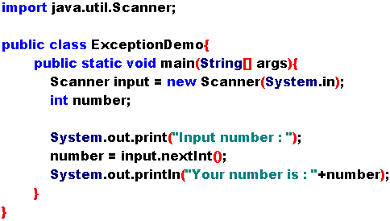
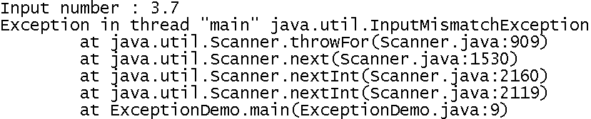
Exception Handling Overview (1)

Slide 39
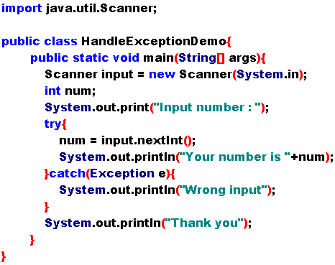

Exception-Handling Overview (2)
Solution?

Slide 40
Runtime Exception Types
Arithmetic Exception
Null Pointer Exception
Index Out of Bounds Exception
Illegal Argument Exception
Etc.

Slide 41
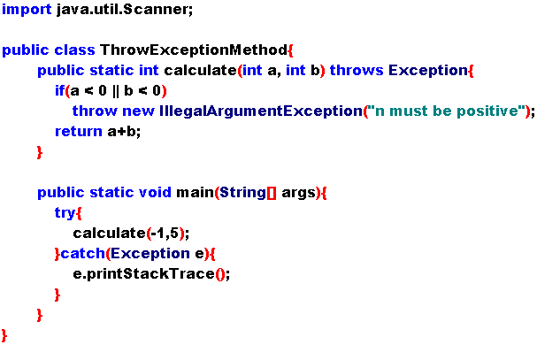
Exceptions Thrown by a Method

Slide 42
Declaring Exceptions
Every method must state the types of checked exceptions it might throw.
Java does not require that you declare Error and RuntimeException (unchecked exceptions)explicitly in the method.
E.g.
public void myMethod()
throws Exception1, Exception2, … , ExceptionN

Slide 43
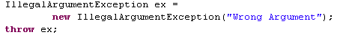
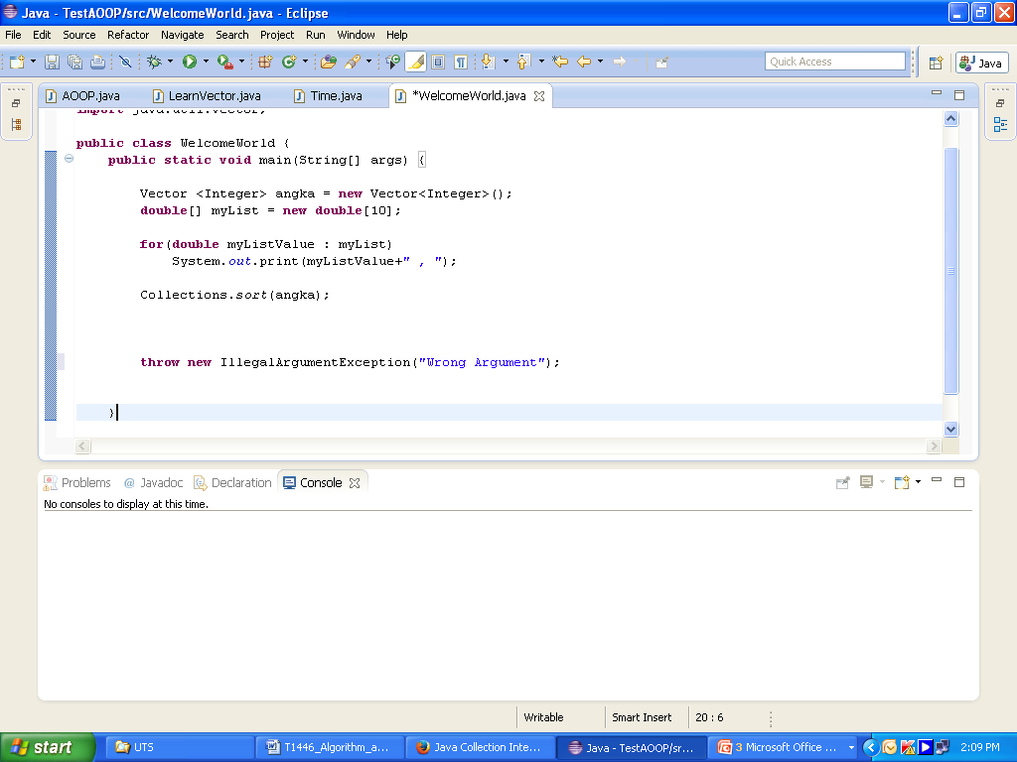
Throwing Exceptions
A program that detects an error can create an instance of an appropriate exception type and throw it. (throwing an exception)
Example:
A program pass a value to a method and the argument must be non-negative, but a negative argument is passed.
The program can create an instance of IllegalArgumentException and throw it as follows:
OR

Slide 44
Catching Exceptions
When an exception is throw, it can be caught and handled in a try-catch block.
try {
//Statement
}
catch (Exception1 exVar1){
//handle exception1
}
catch (Exception2 exVar2){
//handle exception2
}
Getting Information from Exceptions
You can use printStackTrace(), getMessage(), toString(), and getStackTrace() methods in obtain information from exception objects.

Slide 45
The finally Clause
When?
If you want some code to be executed regardless of whether an exception occurs or is caught.
Syntax?
try{
//statement
}
catch(TheException ex){
//handling exception
}
finally{
//final statement
}
finally can declare without catch

Slide 46
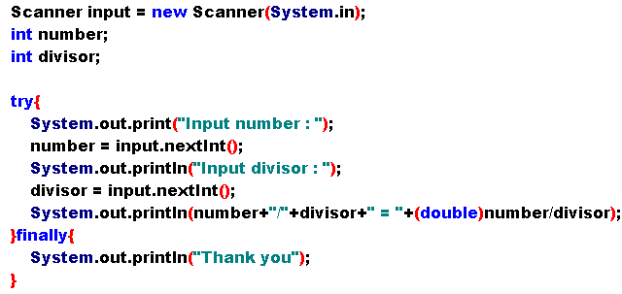
The finally Clause Example (1)

Slide 47
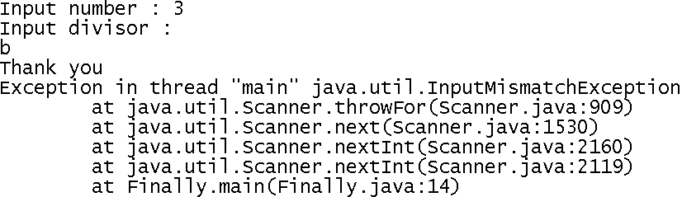
The finally Clause Example (2)
Sample input and the output:

Slide 48
Advanced Learning
Disadvantages try and catch:
Takes much time at executed.
Need more memory
Need handler searching
Advantages try and catch:
Catch complex error
Easy to read and modified

Slide 49
Exercise
Does any method in the String class change the contents of the string?
Create a program to determine whether a character is alphanumeric?
Create a program to determine whether a character is in lowercase or uppercase?
Describe how to convert hexadecimal to decimal?
Evaluate the following method calls:
Math.pow(2,2)
Math.max(2, Math.min(3,4))
Math.round(2.5F)
Math.ceil(-9.49)
Math.floor(7.5)

Slide 50
Exercise
Describe and give example for each method of String
contains
concat
compareTo
format
charAt
replace
substing
trim
toCharArray
split
toLowerCase
toUpperCase

Slide 51
Exercise
Can different types of numeric values be used together in computation?
Assume that int a = 1 and double d = 1.0 and that each expression is independent. What are the results of the following expressions?
a = 46 % 9 + 4 * 4 – 2
a = 45 + 43 % 5 * (23 * 3 % 2)
a %= 3 / a + 3
d += 1.5 * 3 + (++a)
Are the following statements correct? If so, show the output.
System.out.println(“25 / 4 is “ + 25 / 4);
System.out.println(“25 / 4.0 is “ + 25 / 4.0);
System.out.println(“3 * 2 / 4 is “ + 3 * 2 / 4);
System.out.println(“3.0 * 2 / 4 is “ + 3.0 * 2 / 4);

Slide 52
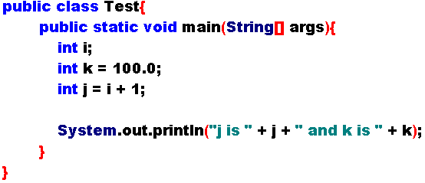




Exercise
Identify and fix the errors in the following code:
Can the following conversions involving casting be allowed? If so, find the converted result.

Slide 53
Exercise
Assuming that x is 1, show the result of the following Boolean expressions.
(true) && (3 > 4)
!(x > 0) && (x > 0)
(x != 1) == !(x == 1)
(x >= 0) || (x < 0)
List the precedence order of the Boolean operators. Evaluate the following expressions:
2 * 2 – 3 > 2 && 4 – 2 > 5
2 * 2 – 3 > 2 || 4 – 2 > 5

Slide 54
Exercise
Assuming that x is 1, show the result of the following Boolean expressions.
(true) && (3 > 4)
!(x > 0) && (x > 0)
(x != 1) == !(x == 1)
(x >= 0) || (x < 0)
List the precedence order of the Boolean operators. Evaluate the following expressions:
2 * 2 – 3 > 2 && 4 – 2 > 5
2 * 2 – 3 > 2 || 4 – 2 > 5

Slide 55
References
Daniel Liang, Y., 2015, Introduction to java programming, vol.10, Pearson Education, New Jersey. Chapter 2.
Java Operator Precedence 3, http://www.cs.uwf.edu/~eelsheik/cop2253/resources/op_precedence.html
Index, http://staff.science.uva.nl/~heck/JAVAcourse/ch4/
Java Operator Precedence 2, http://download.oracle.com/javase/tutorial/java/nutsandbolts/operators.html
Java Operator Precedence 4, http://www.uni-bonn.de/~manfear/javaoperators.php
Java Operator Precedence 1, http://cms.binus.ac.id/Backend2/CO/CourseDetails8.aspx?id=T0974&id2=0#CheckPoint
Java Operator Precedence 5, http://www.cs.princeton.edu/introcs/11precedence/

